Slide 1
13 June 2024 | Microsoft Ibérica HQ
Expert Finder
RAG con datos de MS Graph user profile
Notes:
Template may be modified but please keep the title and the sponsor slide.
Twitter hashtag: #CollabDaysMadrid for all sessions

Slide 2






Sponsors
Platinum
Gold
Bronze
Notes:
Use this as the first slide in your slide deck

Slide 3






Luis Mañez
Chief Architect @ ClearPeople
Co-founder @ RocketMind Academy
MS MVP M365 Development
@luismanez
Ruben Toribio
@luismanez
linkedin.com/in/luismanez
M365 Architect / IA Developer @ DNV
Co-founder @ RocketMind Academy
@Rtoribiog
@Rtoribiog
linkedin.com/in/rubentg

Slide 4


Slide 5
01
RAG Pattern

Slide 6
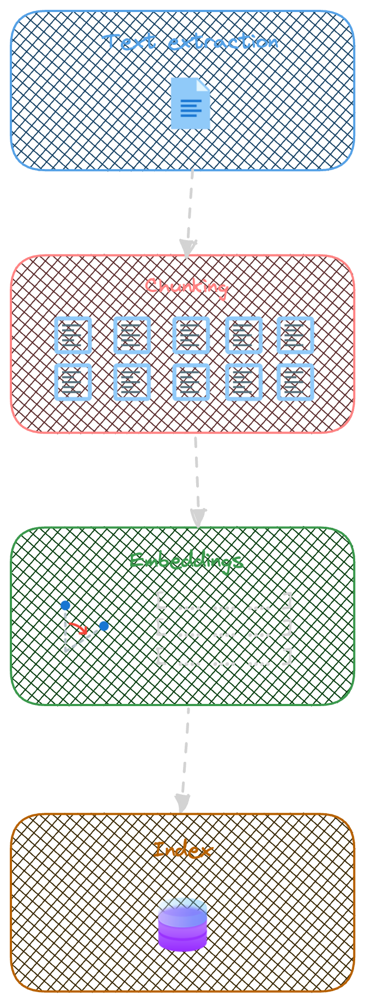
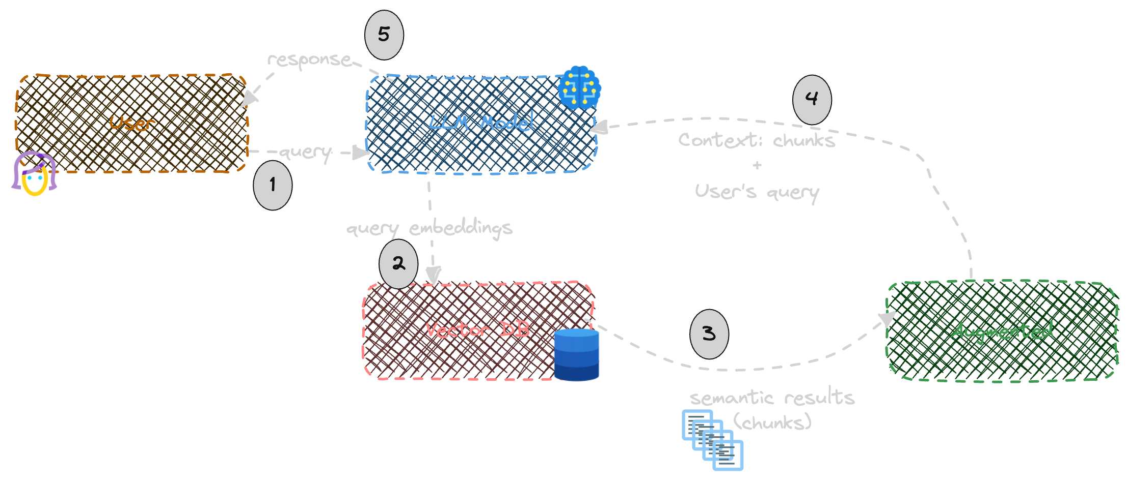
Indexing
Retrieval – Augmented - Generation

Slide 7
02
KernelMemory

Slide 8
Kernel Memory
OpenSource library lead by Microsoft
https://github.com/microsoft/kernel-memory
Integrated with Semantic Kernel
Can run serverless or as a service
Data Formats
Vector Databases
File storage
LLMs
Web pages
PDF
Images
Word
PowerPoint
Excel
Markdown
Text
JSON
HTML
Azure AI Search
Elasticsearch
MongoDB Atlas
Qdrant
Redis
… and more
Disk
Azure Blobs
MongoDB Atlas
In memory (volatile)
Azure OpenAI
OpenAI
LlamaSharp
Anthropic

Slide 9
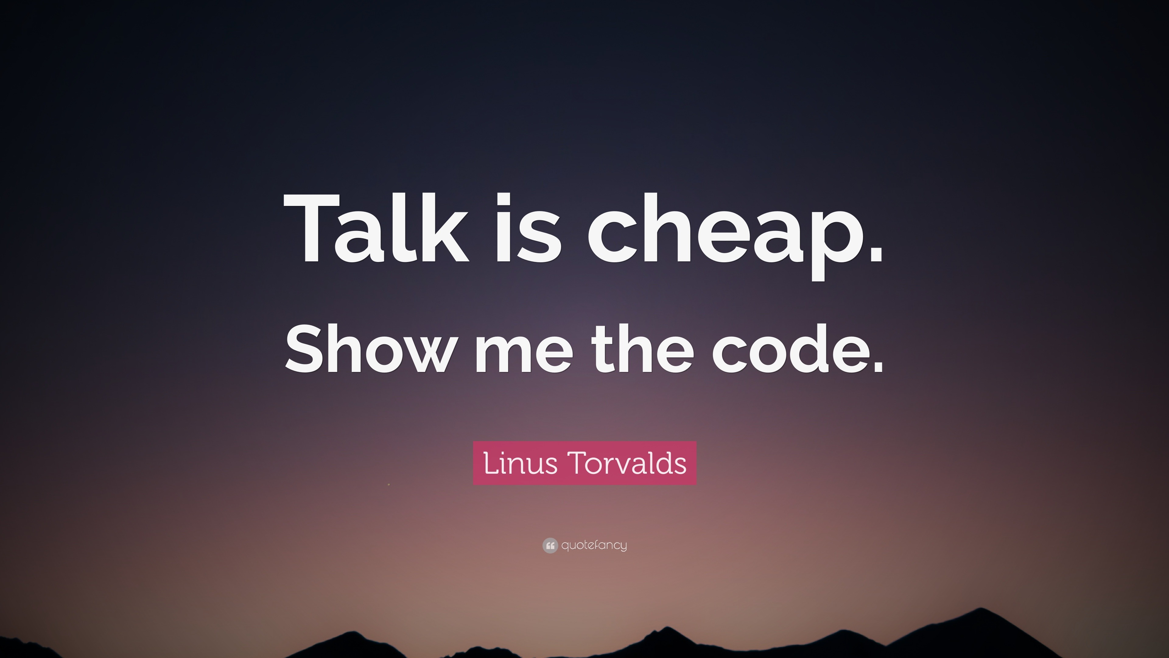

Slide 10
Sponsors
Platinum
Gold
Bronze
Notes:
Use this as the first slide in your slide deck

Slide 11
Thank you!
Questions?

